Slide 1
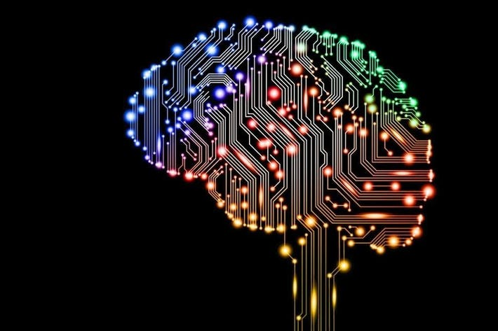

USA Vehicle Number
plates Image Classification
Vamsikrishna Neelam,
U01074399,
neelam.11@wright.edu

Slide 2
Contents
Introduction and Objectives
Dataset information
Data Preprocessing
Deep Learning Models
Architecture of Chosen models
Training and Testing
Results
Limitations and Challenges
Summary and Contributions

Slide 3

The main aim of doing this image classification project is to classify the USA vehicle number plates accurately by using the deep neural networks.
It mainly focuses on the training and testing of the deep neural networks on the image dataset.
At the end a comparison of the chosen deep neural networks will be made so as to justify the best suitable model for the chosen dataset.

Slide 4

The dataset which has been used for the Image classification has been taken from the Kaggle.
The Link for the Kaggle Dataset:
https://www.kaggle.com/datasets/gpiosenka/us-license-plates-image-classification
The dataset has a total of 8441 images divided in to 8161 images into the train dataset and 280 images into the test dataset.
Each image size approximately varies from 15kb to a maximum of 25kb.
The Number plate in the image covers up to 90% of
the total image area.
Each image in any dataset is 128pixels high
and 224pixels wide.

Slide 5

The images are resized from 224 by 128 pixels to 128 by 128 pixels to maintain uniformity.
The images are then rotated by a certain angle of 10degress randomly.
The images are then converted into tensors and mean , standard deviation are calculated for the converted images.
The images are then normalized using the calculated mean and standard deviation.

Slide 6

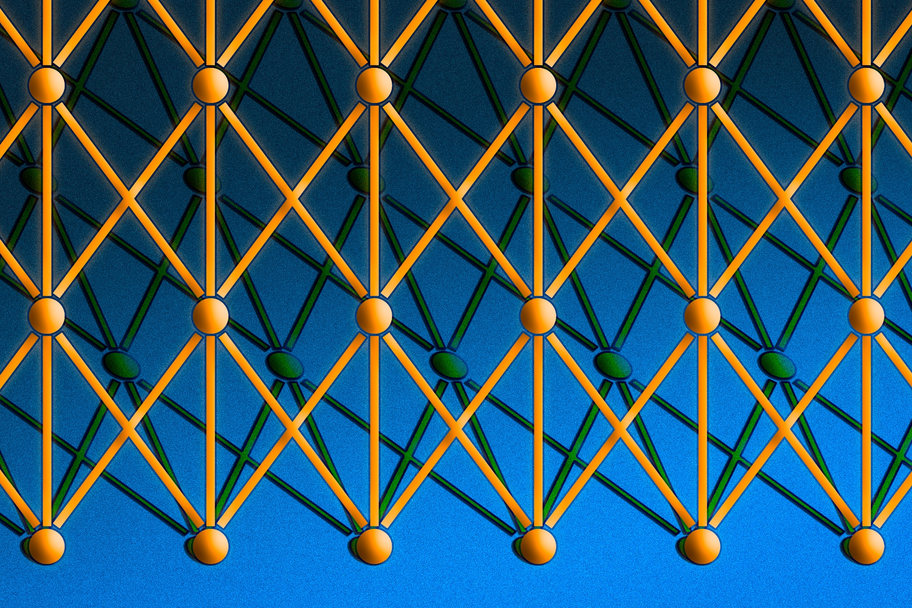
The two different deep learning model called ResNet18 and Alex Net have been chosen for doing the image classification here.
The ResNet18 model has 18 deep layers and the Alex Net has 8 deep layers.
Both of the chosen models are Deep Neural Network models.
The chosen models are non-pretrained models from py-torch framework.
The first model is called as the popular Resnet18 Model and the Second model is known as the popular Alex Net model.
The ResNet18 Model is 18 layers deep while the AlexNet model is only 8 Layers deep.
The architecture of the Resnet18 and the AlexNet models are as shown in the Figure 1 and Figure 2 respectively

Slide 7
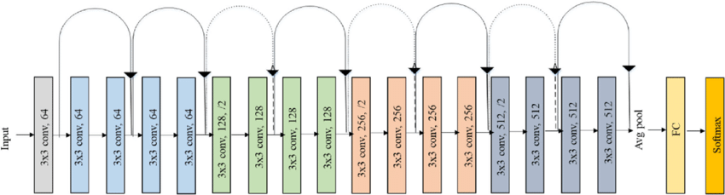
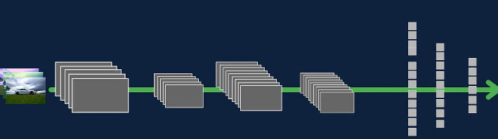
𝑅𝑒𝓈𝒩𝑒𝓉𝟣𝟪 𝒜𝓇𝒸𝒽𝒾𝓉𝑒𝒸𝓉𝓊𝓇𝑒
Figure 1

Slide 8
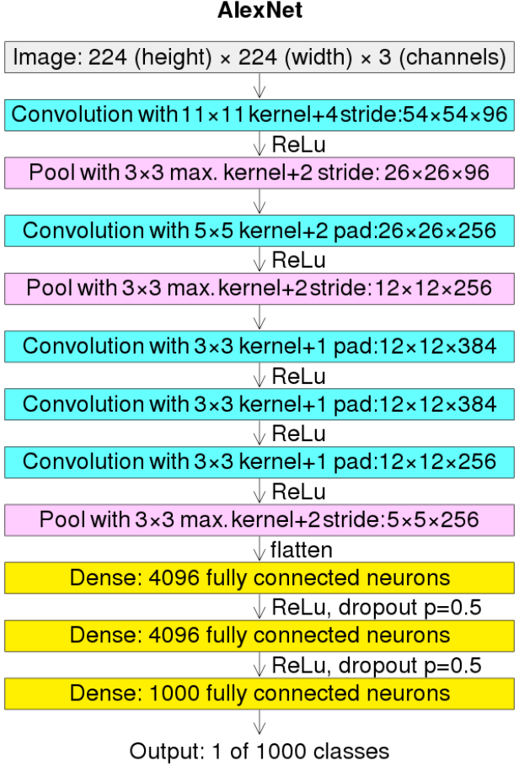
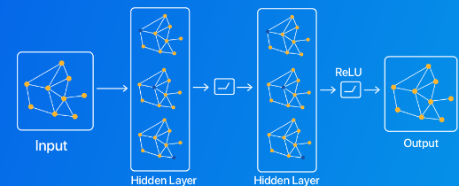
𝓐𝓵𝓮𝔁𝓝𝓮𝓽 𝓐𝓻𝓬𝓱𝓲𝓽𝓮𝓬𝓽𝓾𝓻𝓮
Figure 2

Slide 9

For training any of the chosen machine learning model we are using the mini batch gradient descent to make the training efficient and faster. All the images are processed in batches of size 32.
For calculating the loss the Cross Entropy loss function is being used because it tells how well the model is able to classify the images during the testing phase.
The SGD(Stochastic Gradient Descent) is being used as the optimizer because it helps to reduce the cost function based on the prediction errors in the forward and backward propagation of the neural networks.
We are training and testing the chosen models over a range of 100 epochs and adjusting the hyperparameters for various values.
After playing around the various values for hyperparameters the best learning rate and weight decay for ResNet18 model are found to be 0.01 and 0.003 respectively.
Similarly for the Alex net the best values for the hyperparameters learning rate and weight decay are 0.01 and 0.001 respectively.

Slide 10

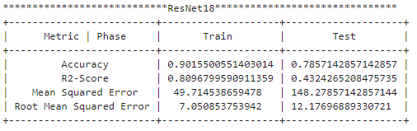
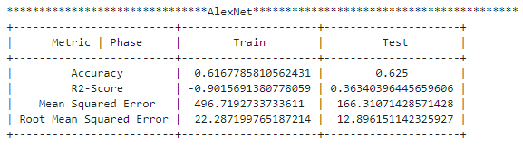
For the best hyperparameters the different metrices for the ResNet18 and AlexNet models
are as given in the tables 1 and 2 respectively along with the corresponding graphs in Figure 3.
Table 1
Table 2

Slide 11
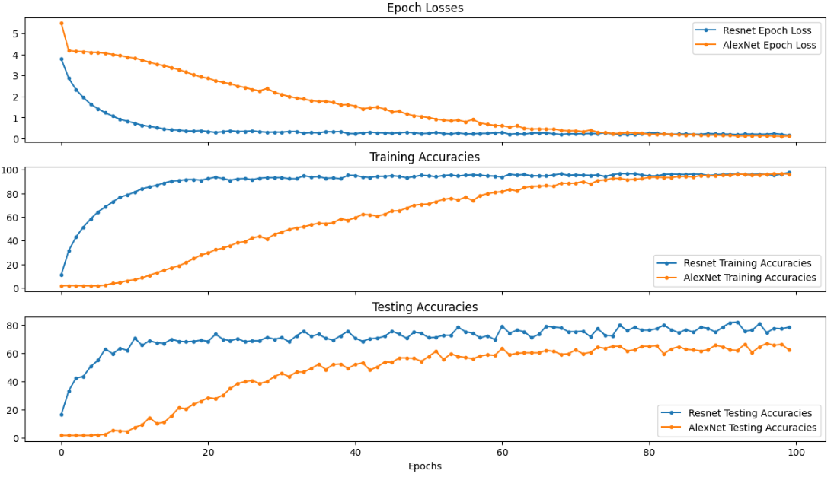

Slide 12
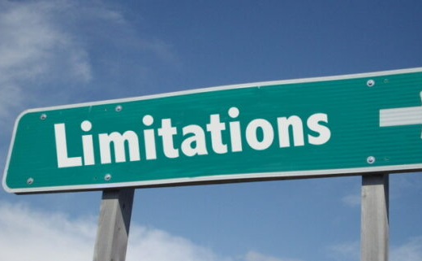
The AlexNet model is not much suitable for the real-time image classifications because it is not deep enough.
The deep learning models always expect all the images to be of same size.
The ResNet is generally less interpretable so it cannot be used for crucial tasks.
The AlexNet is facing the problem of Vanishing Gradients so the ResNet came in to use.
The newer versions of the ResNet are very deep which will be challenging to use when there are limited computational resources.

Slide 13




Summary and Conclusions:
Based on the observations for the chosen dataset the ResNet18 model is best when compared to the AlexNet model.
The models have been imported from the PyTorch Framework and they have been used as is without any modifications to the number of layers, nodes etc., because the standard models have been stated to perform best after an enormous amount of research is done.
Technologies and Frameworks used:
Python 3.11.6 along with several other packages
PyTorch Framework
Jupyter Notebook
Scikit Learn

Slide 14


Slide 15

Questions

